Slide 1
Module II Supervised and Unsupervised Learning

Slide 2
Supervised & Unsupervised Learning – Introduction
Supervised Learning using labeled data
Learns mapping from input to output
Used for regression and classification
Supervised Learning: Data and corresponding labels are given
Example: House price prediction
Unsupervised Learning is a type of machine learning where the model is trained using unlabeled data.
Only input features X are given
No predefined output labels
The model discovers hidden patterns or structures in data.
No correct answers are provided
Model learns on its own by identifying similarity, distance, or density
Example:Customer segmentation in e-commerce

Slide 3
Discriminative and Generative Models
Computers utilize mathematics, algorithms, and data pipelines to draw meaningful inferences from raw data since they cannot perceive data and information like humans
Mathematics, especially branches like calculus, probability, statistics, etc., is the backbone of these algorithms or models. They can be widely divided into two groups:
1. Discriminative models 2. Generative models

Slide 4
Discriminative model
Discriminative models, aka conditional models, are used for supervised machine learning.
Separating the data points into different classes and learning the boundaries using probability estimates and maximum likelihood.
Learn P(Y|X)
Use model capacity to characterize the decision boundary only
Examples:
Spam Filter: Classifies emails as "spam" or "not spam".
Image Classifier: Decides if an image contains a "cat" or "dog".

Slide 5
Widely used discriminative models:
1. Logistic regression
2. Support vector machines
3. Decision trees
4.Neural nets
5.k-nearest neighbor (KNN)
6.Conditional random field (CRF)
7. Random forest, etc.

Slide 6
Generative model
Generative models can be used to generate new data points.
These models are usually used in unsupervised machine learning problems.
Generative models go in-depth to model the actual data distribution and learn the different data points.
Learn P(X,Y)-Use the capacity of the model to characterize how the data is generated(both the input and outputs)
Examples:
GPT Models (e.g., ChatGPT): Generates human-like text, summaries, or code.
Image Synthesis: Drawing a new, never-before-seen picture of a dog.

Slide 7
examples as well as a description of generative models
1. Bayesian network
2. Autoregressive model
3. Generative adversarial network (GAN)
4.Naive Bayes
5.Markov random field
6.hidden Markov model (HMM)
7.latent Dirichlet allocation (LDA), etc

Slide 8
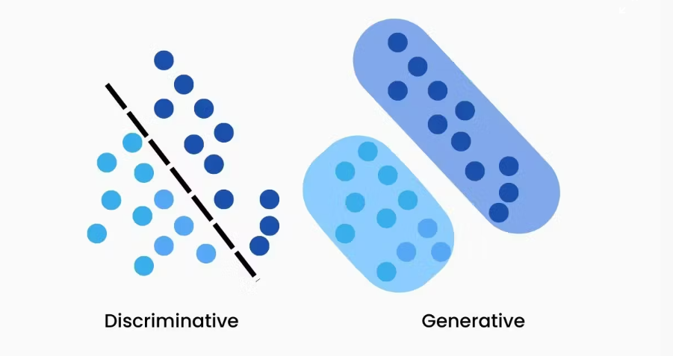
Discriminative vs generative

Slide 9
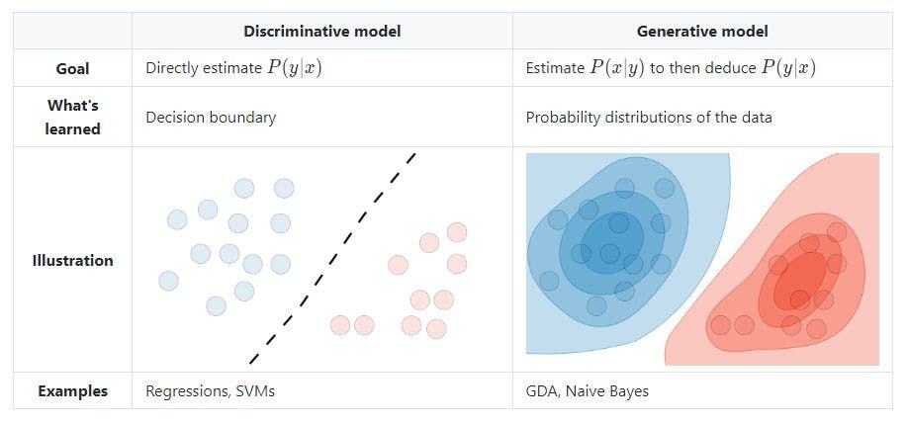
Discriminative vs generative

Slide 10
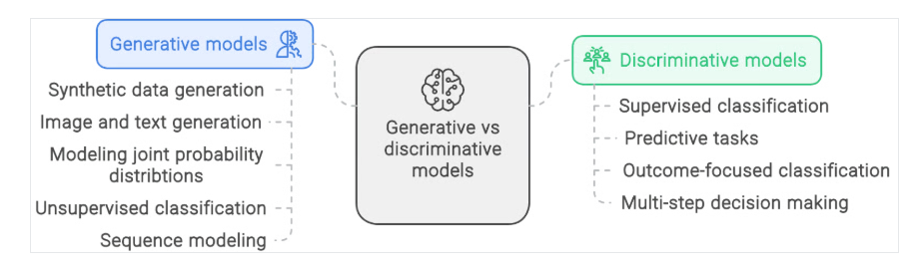
Applications of Discriminative vs generative

Slide 11
Summary
Discriminative models learn P(Y|X)
Generative models learn P(X,Y)
Focus: boundary vs distribution
Examples: Logistic Regression, Naïve Bayes

